Slide 1
ME476C Prototype II
Aaron Espinoza, Maciej Ziomber, Steven Galloway, Janelle Peña, Courtney Hiatt
Notes:
Janelle
Hook for the audience
Population size
Storytelling vs telling a story
Call on someone I know. Ask them the question… What is one resource every single person and living creature needs to survive? Ans… Water. What is something that almost everyone uses every single day?.... Electricity…. Both water and electricity are a We need both to live in these modern days. Our team has created a system that allows us to do both. We have designed a hydro power plant using waste water from old uranium mines to generate and provide electricity to those without power. The team that has accomplished this goal is myself Janelle Peña…..

Slide 2
Prototype Objective
66.6% Calcium Chloride Hexahydrate 33.3% Magnesium Chloride Hexahydrate
Molecular Weight | ? | g/mol
Inlet Temperature(C)
Outlet Temperature(C)
Temperture Difference: |  | 0
Known:
mass(m)
Melting Point (C)
specific heat(Cp)
heat of fusion(F) [kJ/kg] |  | 127
Density (rho) [kg/m^3] |  | 1590
Pressure (P)
volume(V)
Thermal Energy Stored(Q) |  | 0
Change in Internal Energy (U) |  | 0
Specific Enthalpy (h) |  | 0
Phase Change Enthalpy (H) |  | 0
Energy Storage Capacity (ESC) |  | 0
The main purpose of this experiment is to test Phase Change Materials (PCM) for a future integration into a Thermal Energy Storage (TES)
The Phase Change Material that is being tested is a mix of Magnesium Chloride Hexahydrate and Calcium Chloride Hexahydrate
Measurements Taken:
Temperature Difference between the inlet and outlet of the fluid to fluid heat exchanger
Volumetric Flow Rate
Energy generated during the phase change
Notes:
Janelle
Hook for the audience
Population size
Storytelling vs telling a story
Call on someone I know. Ask them the question… What is one resource every single person and living creature needs to survive? Ans… Water. What is something that almost everyone uses every single day?.... Electricity…. Both water and electricity are a We need both to live in these modern days. Our team has created a system that allows us to do both. We have designed a hydro power plant using waste water from old uranium mines to generate and provide electricity to those without power. The team that has accomplished this goal is myself Janelle Peña…..

Slide 3
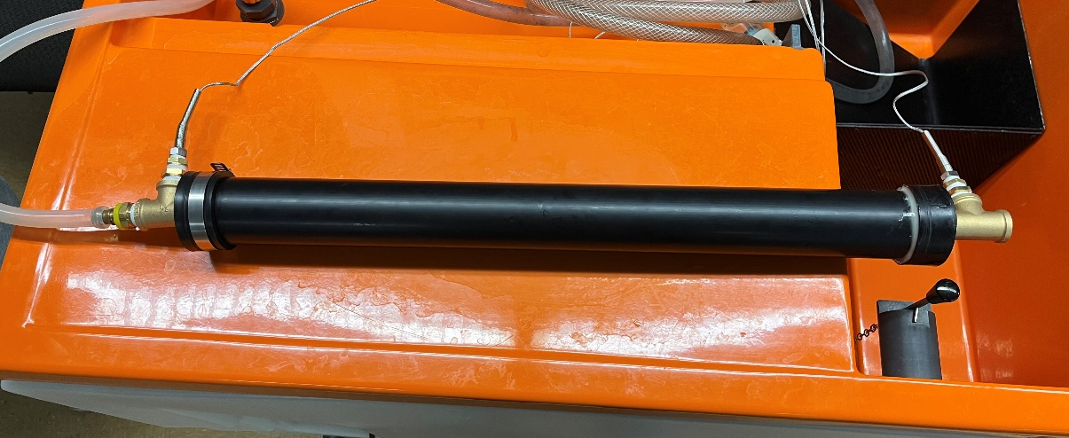
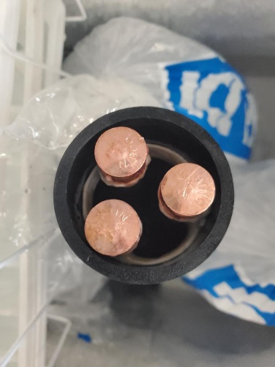
Experimental Design & Method
Experimental Setup:
ABS pipe (2 in diameter, 2 ft long) capped with JB weld and hose clamps
3 Copper tubes (0.5 in diameter, 2 ft long)
Tee fittings on ends with barbed fitting for tubing from a hydraulic bench
Thermocouples on both ends, spaced by nipples and fittings
Mixture:
$$Cal_{2}∗6H_{2}O+MgCl_{2}∗6H_{2}O$$
Notes:
Janelle
Hook for the audience
Population size
Storytelling vs telling a story
Call on someone I know. Ask them the question… What is one resource every single person and living creature needs to survive? Ans… Water. What is something that almost everyone uses every single day?.... Electricity…. Both water and electricity are a We need both to live in these modern days. Our team has created a system that allows us to do both. We have designed a hydro power plant using waste water from old uranium mines to generate and provide electricity to those without power. The team that has accomplished this goal is myself Janelle Peña…..

Slide 4
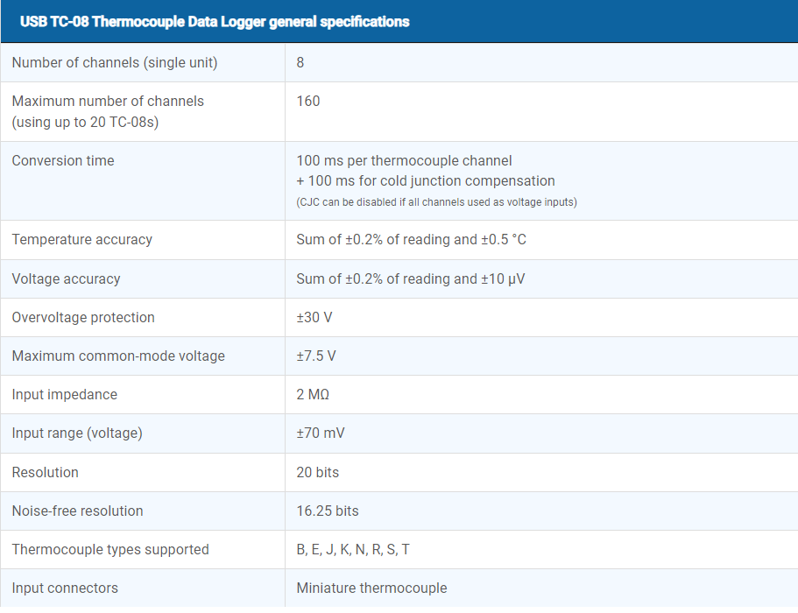
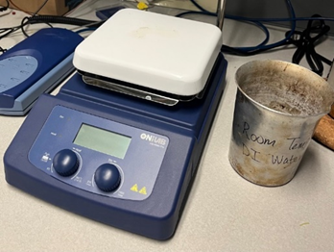
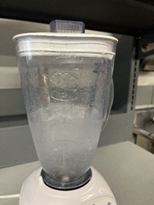
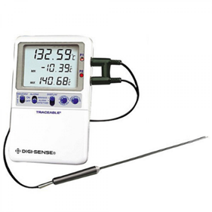
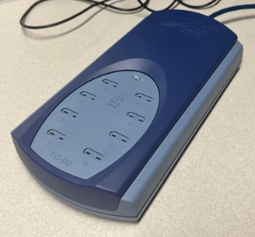
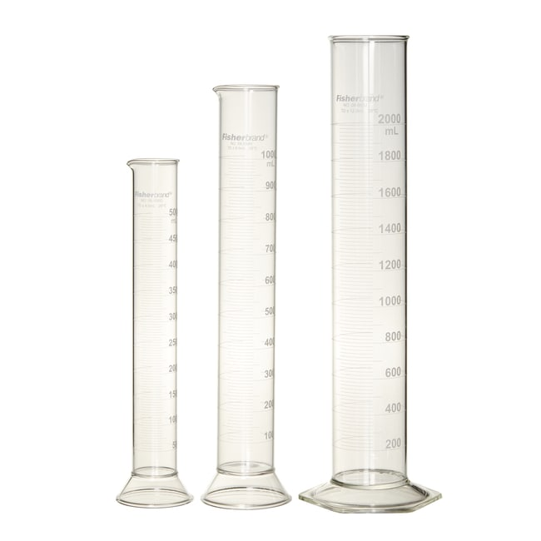
Experimental Design & Method
Data Acquisition:
Pico Data Logger
K-Type Threaded Thermocouples
Bucket-Timer Test
Hydraulic Bench
Graduated Cylinder
Notes:
Janelle
Hook for the audience
Population size
Storytelling vs telling a story
Call on someone I know. Ask them the question… What is one resource every single person and living creature needs to survive? Ans… Water. What is something that almost everyone uses every single day?.... Electricity…. Both water and electricity are a We need both to live in these modern days. Our team has created a system that allows us to do both. We have designed a hydro power plant using waste water from old uranium mines to generate and provide electricity to those without power. The team that has accomplished this goal is myself Janelle Peña…..

Slide 5
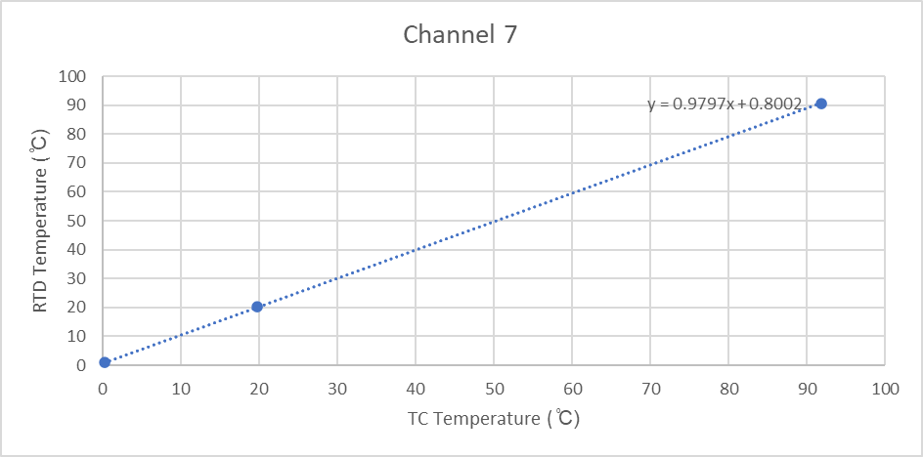
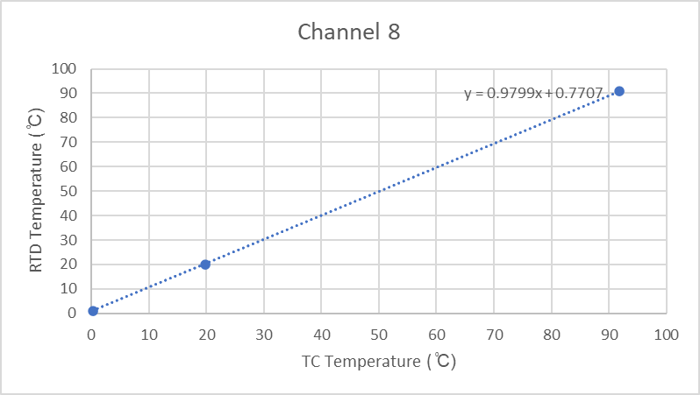
Data and Results
TC Calibration:
Notes:
Janelle
Hook for the audience
Population size
Storytelling vs telling a story
Call on someone I know. Ask them the question… What is one resource every single person and living creature needs to survive? Ans… Water. What is something that almost everyone uses every single day?.... Electricity…. Both water and electricity are a We need both to live in these modern days. Our team has created a system that allows us to do both. We have designed a hydro power plant using waste water from old uranium mines to generate and provide electricity to those without power. The team that has accomplished this goal is myself Janelle Peña…..

Slide 6
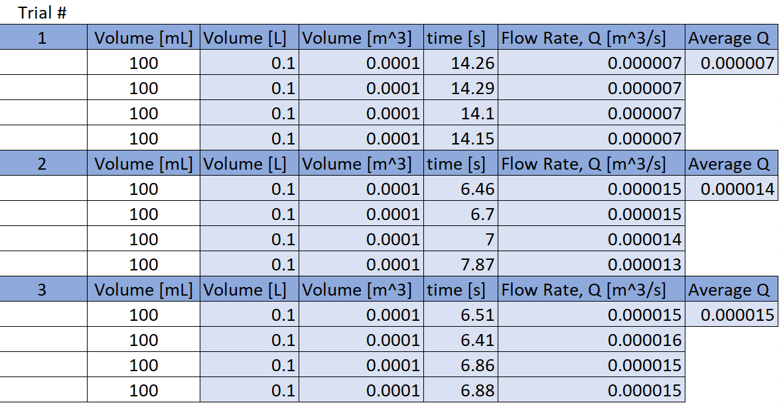
Data & Results
We used a slow bucket-timer flow rates with room temperature water from the hydraulic bench.
Notes:
Janelle
Hook for the audience
Population size
Storytelling vs telling a story
Call on someone I know. Ask them the question… What is one resource every single person and living creature needs to survive? Ans… Water. What is something that almost everyone uses every single day?.... Electricity…. Both water and electricity are a We need both to live in these modern days. Our team has created a system that allows us to do both. We have designed a hydro power plant using waste water from old uranium mines to generate and provide electricity to those without power. The team that has accomplished this goal is myself Janelle Peña…..

Slide 7
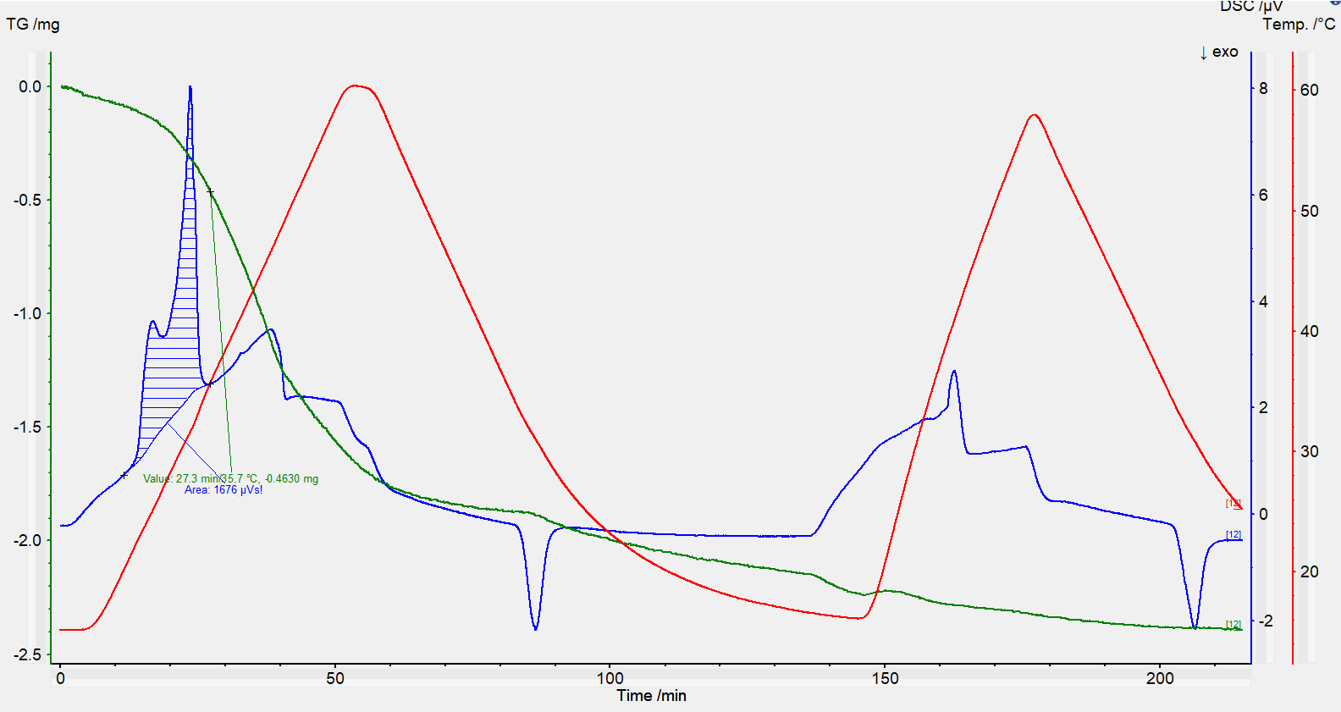
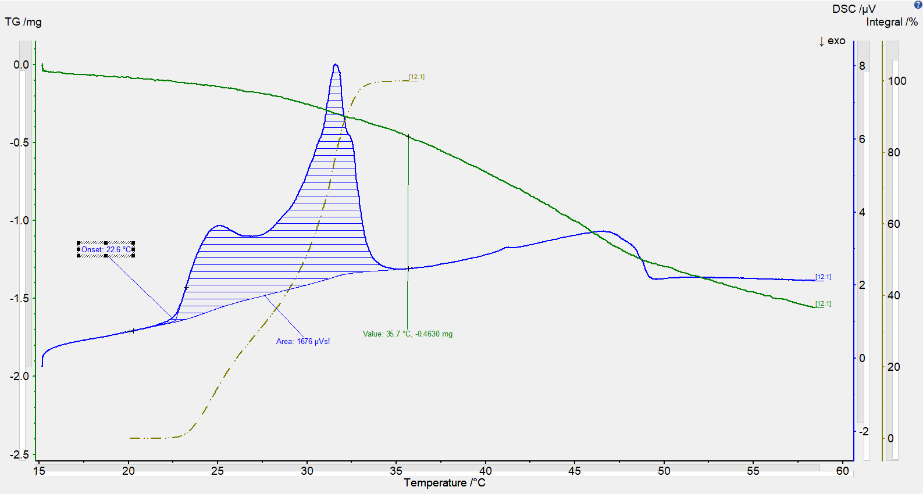
Data & Results
Dr. Wade provided us with data on the properties of the materials:
Full melt profile
Two melting events
Notes:
Janelle
Hook for the audience
Population size
Storytelling vs telling a story
Call on someone I know. Ask them the question… What is one resource every single person and living creature needs to survive? Ans… Water. What is something that almost everyone uses every single day?.... Electricity…. Both water and electricity are a We need both to live in these modern days. Our team has created a system that allows us to do both. We have designed a hydro power plant using waste water from old uranium mines to generate and provide electricity to those without power. The team that has accomplished this goal is myself Janelle Peña…..

Slide 8
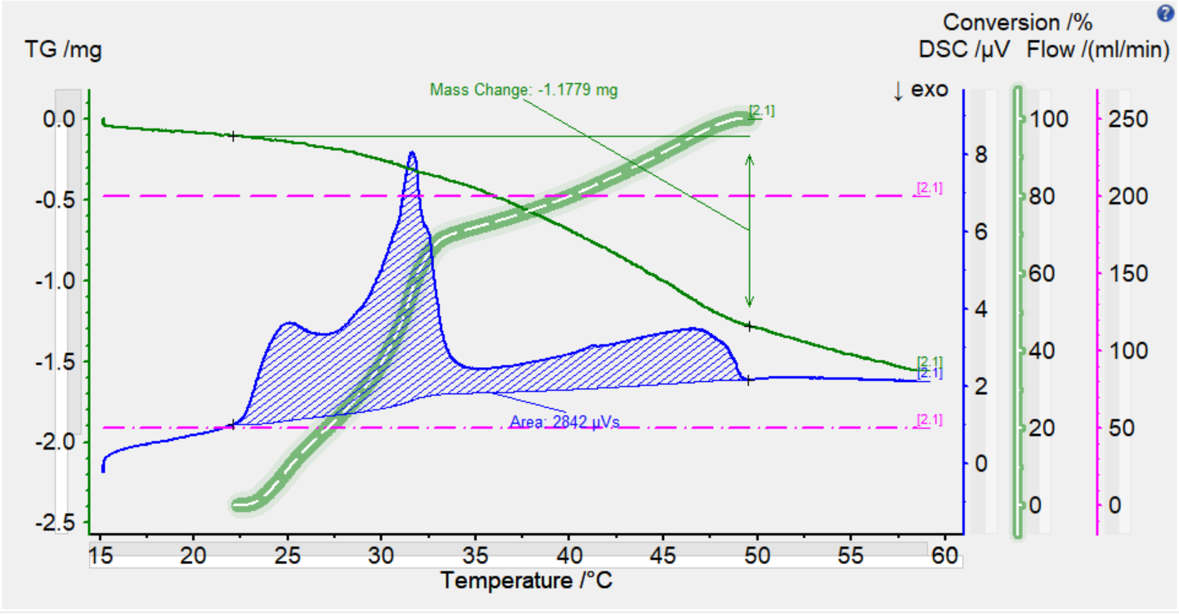
Data & Results
Dr. Wade provided us with data on the properties of the materials:
Q = 2842 uVs * 0.0012656 J/uVs = 3.57 J
Qmelt = 3.57 J / .0229 g = 156 J/g (error due to mass loss) - Latent heat
Notes:
Janelle
Hook for the audience
Population size
Storytelling vs telling a story
Call on someone I know. Ask them the question… What is one resource every single person and living creature needs to survive? Ans… Water. What is something that almost everyone uses every single day?.... Electricity…. Both water and electricity are a We need both to live in these modern days. Our team has created a system that allows us to do both. We have designed a hydro power plant using waste water from old uranium mines to generate and provide electricity to those without power. The team that has accomplished this goal is myself Janelle Peña…..

Slide 9
Data & Results
Temperature vs. Time Plots:
Consistently has a difference of approximately 2 °C from inlet to outlet as material phase changes
Phase change occurrence visible as lines intersect.
Notes:
Janelle
Hook for the audience
Population size
Storytelling vs telling a story
Call on someone I know. Ask them the question… What is one resource every single person and living creature needs to survive? Ans… Water. What is something that almost everyone uses every single day?.... Electricity…. Both water and electricity are a We need both to live in these modern days. Our team has created a system that allows us to do both. We have designed a hydro power plant using waste water from old uranium mines to generate and provide electricity to those without power. The team that has accomplished this goal is myself Janelle Peña…..

Slide 10
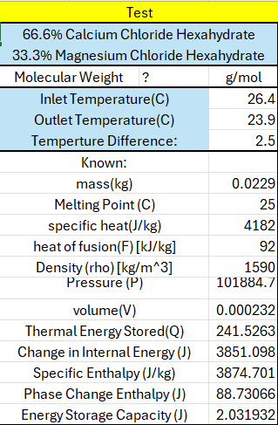
Calculations
Heat Transfer Rate:
Notes:
Janelle
Hook for the audience
Population size
Storytelling vs telling a story
Call on someone I know. Ask them the question… What is one resource every single person and living creature needs to survive? Ans… Water. What is something that almost everyone uses every single day?.... Electricity…. Both water and electricity are a We need both to live in these modern days. Our team has created a system that allows us to do both. We have designed a hydro power plant using waste water from old uranium mines to generate and provide electricity to those without power. The team that has accomplished this goal is myself Janelle Peña…..

Slide 11
Calculations
Heat Transfer Rate:
Notes:
Janelle
Hook for the audience
Population size
Storytelling vs telling a story
Call on someone I know. Ask them the question… What is one resource every single person and living creature needs to survive? Ans… Water. What is something that almost everyone uses every single day?.... Electricity…. Both water and electricity are a We need both to live in these modern days. Our team has created a system that allows us to do both. We have designed a hydro power plant using waste water from old uranium mines to generate and provide electricity to those without power. The team that has accomplished this goal is myself Janelle Peña…..

Slide 12
Calculations
Error and Uncertainty calculations:
Notes:
Janelle
Hook for the audience
Population size
Storytelling vs telling a story
Call on someone I know. Ask them the question… What is one resource every single person and living creature needs to survive? Ans… Water. What is something that almost everyone uses every single day?.... Electricity…. Both water and electricity are a We need both to live in these modern days. Our team has created a system that allows us to do both. We have designed a hydro power plant using waste water from old uranium mines to generate and provide electricity to those without power. The team that has accomplished this goal is myself Janelle Peña…..

Slide 13
Future Work
Keep experimental apparatus in thermal equilibrium by capping ends and filling with room temp water.
Running the system with hot and cold water (above and below 22 °C)
Run hot above 30 °C
Next semester transition to air flowing through device
Notes:
Janelle
Hook for the audience
Population size
Storytelling vs telling a story
Call on someone I know. Ask them the question… What is one resource every single person and living creature needs to survive? Ans… Water. What is something that almost everyone uses every single day?.... Electricity…. Both water and electricity are a We need both to live in these modern days. Our team has created a system that allows us to do both. We have designed a hydro power plant using waste water from old uranium mines to generate and provide electricity to those without power. The team that has accomplished this goal is myself Janelle Peña…..

